Slide 1
ONLNE EMPLOYEE REGISTRATION SYSTEM
SUVAM KUMAR NANDA
RegdNo:1901287215
Gr-No:59

Slide 2
ABSTRACT
Online Employee Registration System Project is essential software designed to keep track of employee information in any company. It stores data such as their employees’ personal information. The goal of the “Online Employee Registration System” is to create a work center scheduling system. Scheduling is a technology that makes the process of informing activities and notifications in the company where it is implemented simply and even online.

Slide 3
CONTENTS
1. INTRODUCTION
2.OBJECTIVE
3.DEVELOPEMENT OF THE SYSTEM
Hardware Requirements
Software Requirements
4.COMPONENETS OF THE SYSTEM
5.DIFFERENT MODULES
6.BLOCK DIAGRAM OF THE PROJECTS
7.SNAPSHOTS
8.CONCLUSION

Slide 4
INTRODUCTION
Online Employee Registration system is an application that enables users to create and store Employee Records.
Java is a platform independent language. Its created applications can be used on a standalone machine as well as on distributed network. More over applications developed in java can be extended to Internet based applications. Thus java was chosen as background to design this application. It is basically maintained by the Admin of an Organization.
This will be a GUI-based program with Oracle as a database.
Login
Add employee
View employees
Edit employee
Delete employee
Save data

Slide 5
OBJECTIVE
In this world of growing technologies everything has been computerized. With large number of work opportunities the Human workforce has increased. Thus there is a need of a system which can handle the data of such a large number of Employees in an organization. This project simplifies the task of maintain records because of its user friendly nature.

Slide 6
Development of the system
HARDWARE REQUIREMENT
RAM - 4GB
HDD - 256GB
PROCESSOR - Intel Pentium IV, 1GHZ or above
software REQUIREMENT
OPERATING SYSTEM - Windows10 (64 bit)
DEVELOPING LANGUAGE - Java (JDK 17)
DEVELOPING TOOL - Eclipse (2022 09)
DATABASE - Oracle Database 19c
SERVER - Tomcat V9.0

Slide 7
COMPONENT OF THE SYSTEM
The components of the project “Online Employee Registration System” are
i)Front-End
ii)Back-End
i)Front-End:
Front-End of this project is Designed by the help of HTML and CSS
ii)Back-End
For the Back-End We have Used
JDBC
SERVLET
ORACLE 19C DATABASE
TOMCAT V9 SERVER

Slide 8
HTML:
HTML stands for Hyper Text Markup Language
HTML is the standard markup language for creating Web pages
HTML describes the structure of a Web page
In this Project HTML helped us to create The form to add and to Edit Employee Details.
CSS:
CSS stands for Cascading Style Sheets
CSS describes how HTML elements are to be displayed on screen, paper, or in other media
CSS saves a lot of work. It can control the layout of multiple web pages all at once
In This Project CSS Basically Provided the style to the Front-End such as The Backgroud Color,Style of Save Button etc

Slide 9
JDBC:
JDBC Stands for Java Database Connectivity
Implementation class Of JDBC Provided By Different Vendor
For Example:
JDBC Class Implementation provided by Oracle Corporation is specific to oracle database .
It Provides the Driver to that takes query from the Front-end and Executes the query on database and Stores the result in a ResultSet Object.
JDBC Provides JDBC-ODBC bridge Driver that establishes the connection with the Database

Slide 10
SERVLET:
A servlet is a Java programming language class that is used to extend the capabilities of servers that host applications accessed by means of a request-response programming model. Although servlets can respond to any type of request, they are commonly used to extend the applications hosted by web servers.
Here HTTP Protocol acts as the Birdge Between the Client and the server and It provides the Information
About the Type of the Request sent by the Client
Request Request(text/html)
Response(text/html) Response(text/html)
ORACLE 19 C
It is the Database Provided by the Oracle Corporation
Client
Server
HTTP Protocol

Slide 11
Different MODULES
There are basically 4 modules in this Project
i)Add Employee: Here all the details of the employee are added
ii)View Employee: In this page we can see all the existing employee details
iii)Edit Employee: here we can edit the existing details of the employee and save them.
iv)Delete Employee: It helps us to delete the employee details

Slide 12
Block Diagram of the Project
Oracle
Database
Delete Employee
Add Employee
View Employee
Edit Employee

Slide 13
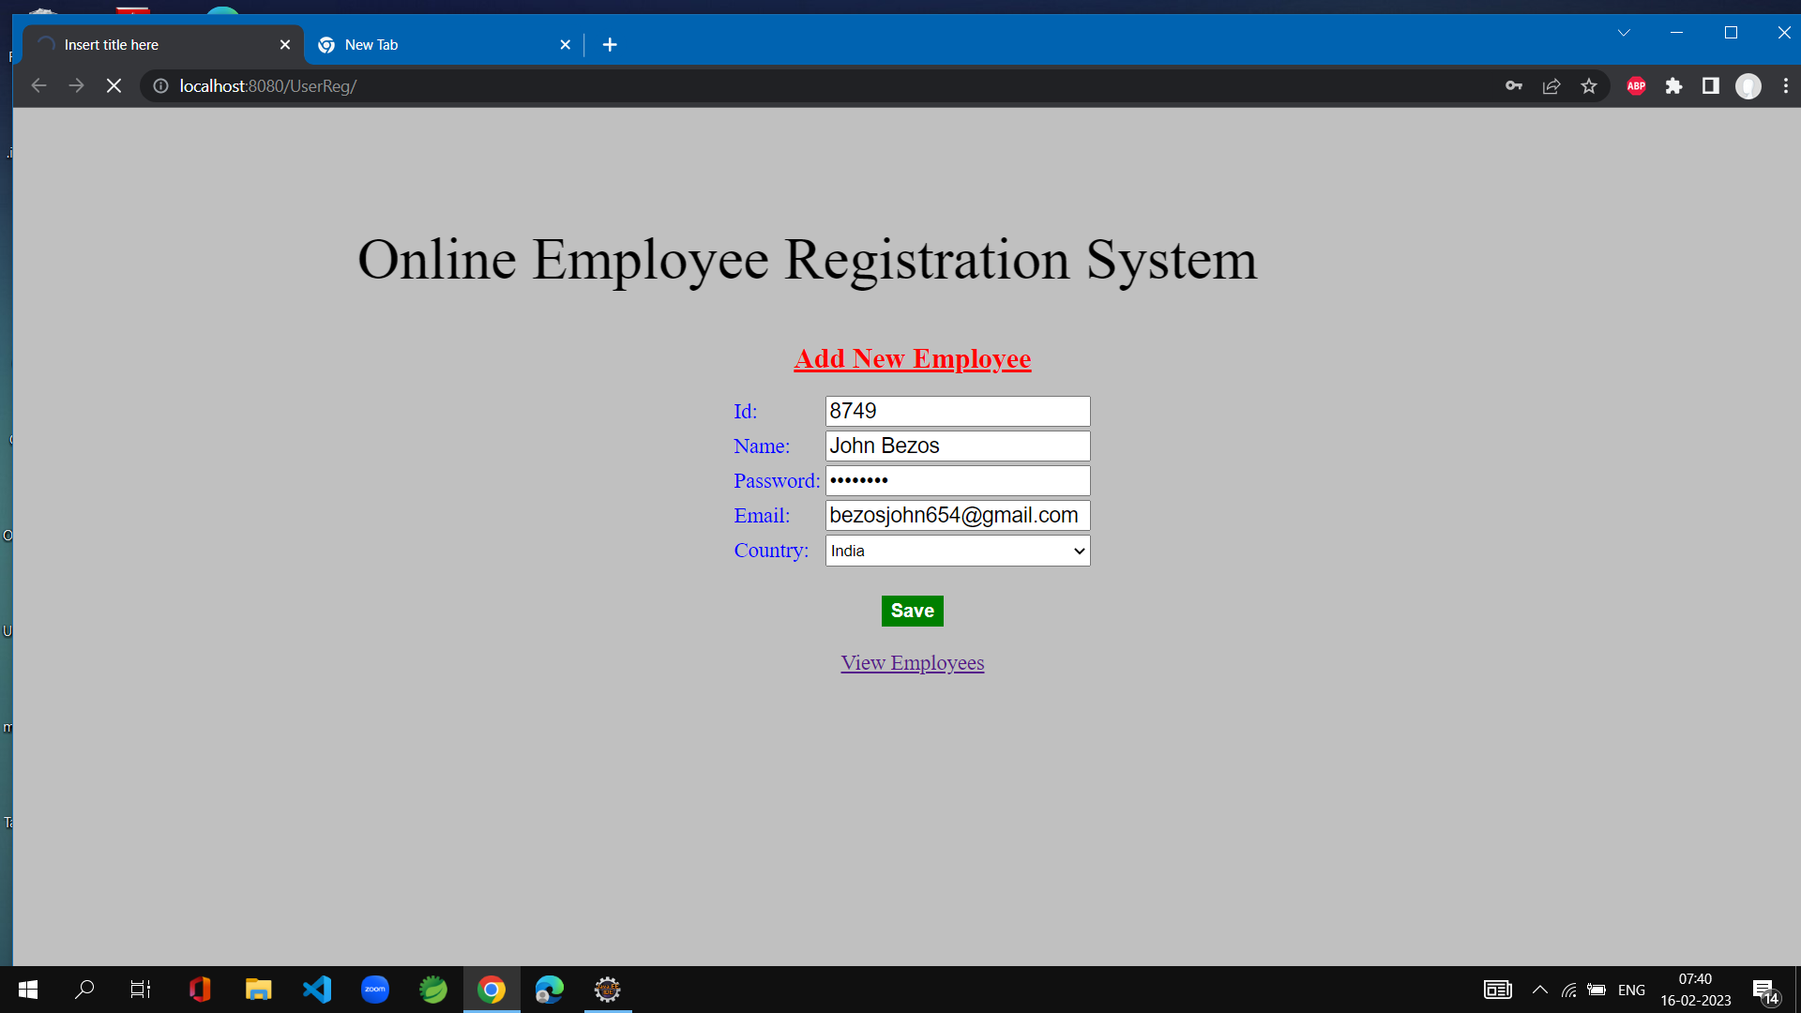
SNAPSHOTS
Add Employee Page

Slide 14
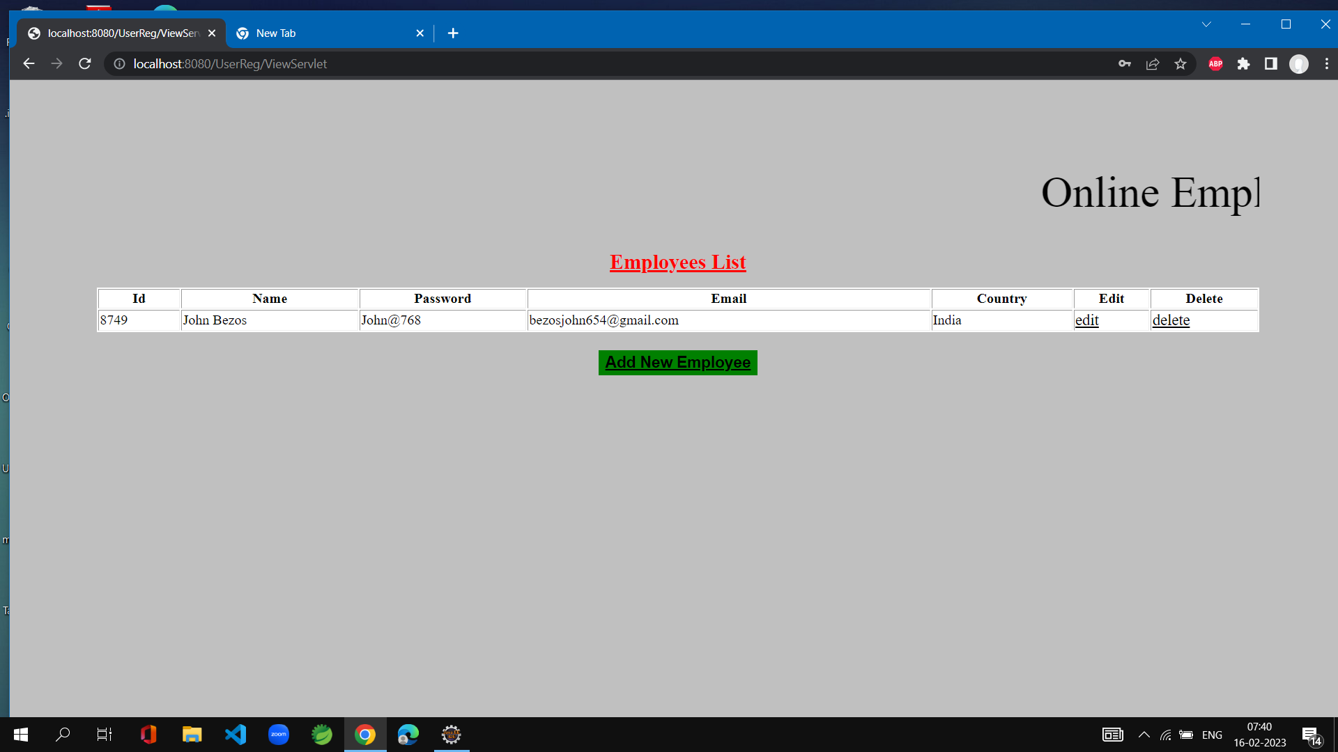
View Employee

Slide 15
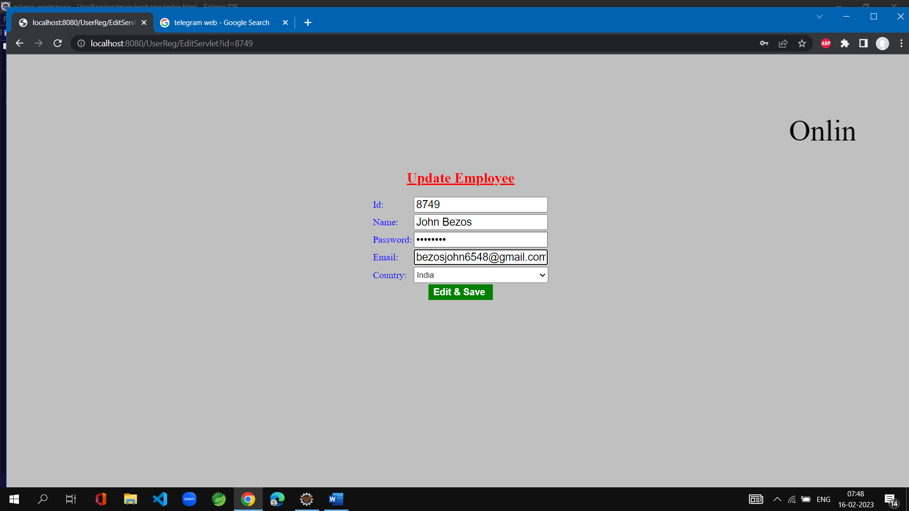
Edit & Save

Slide 16
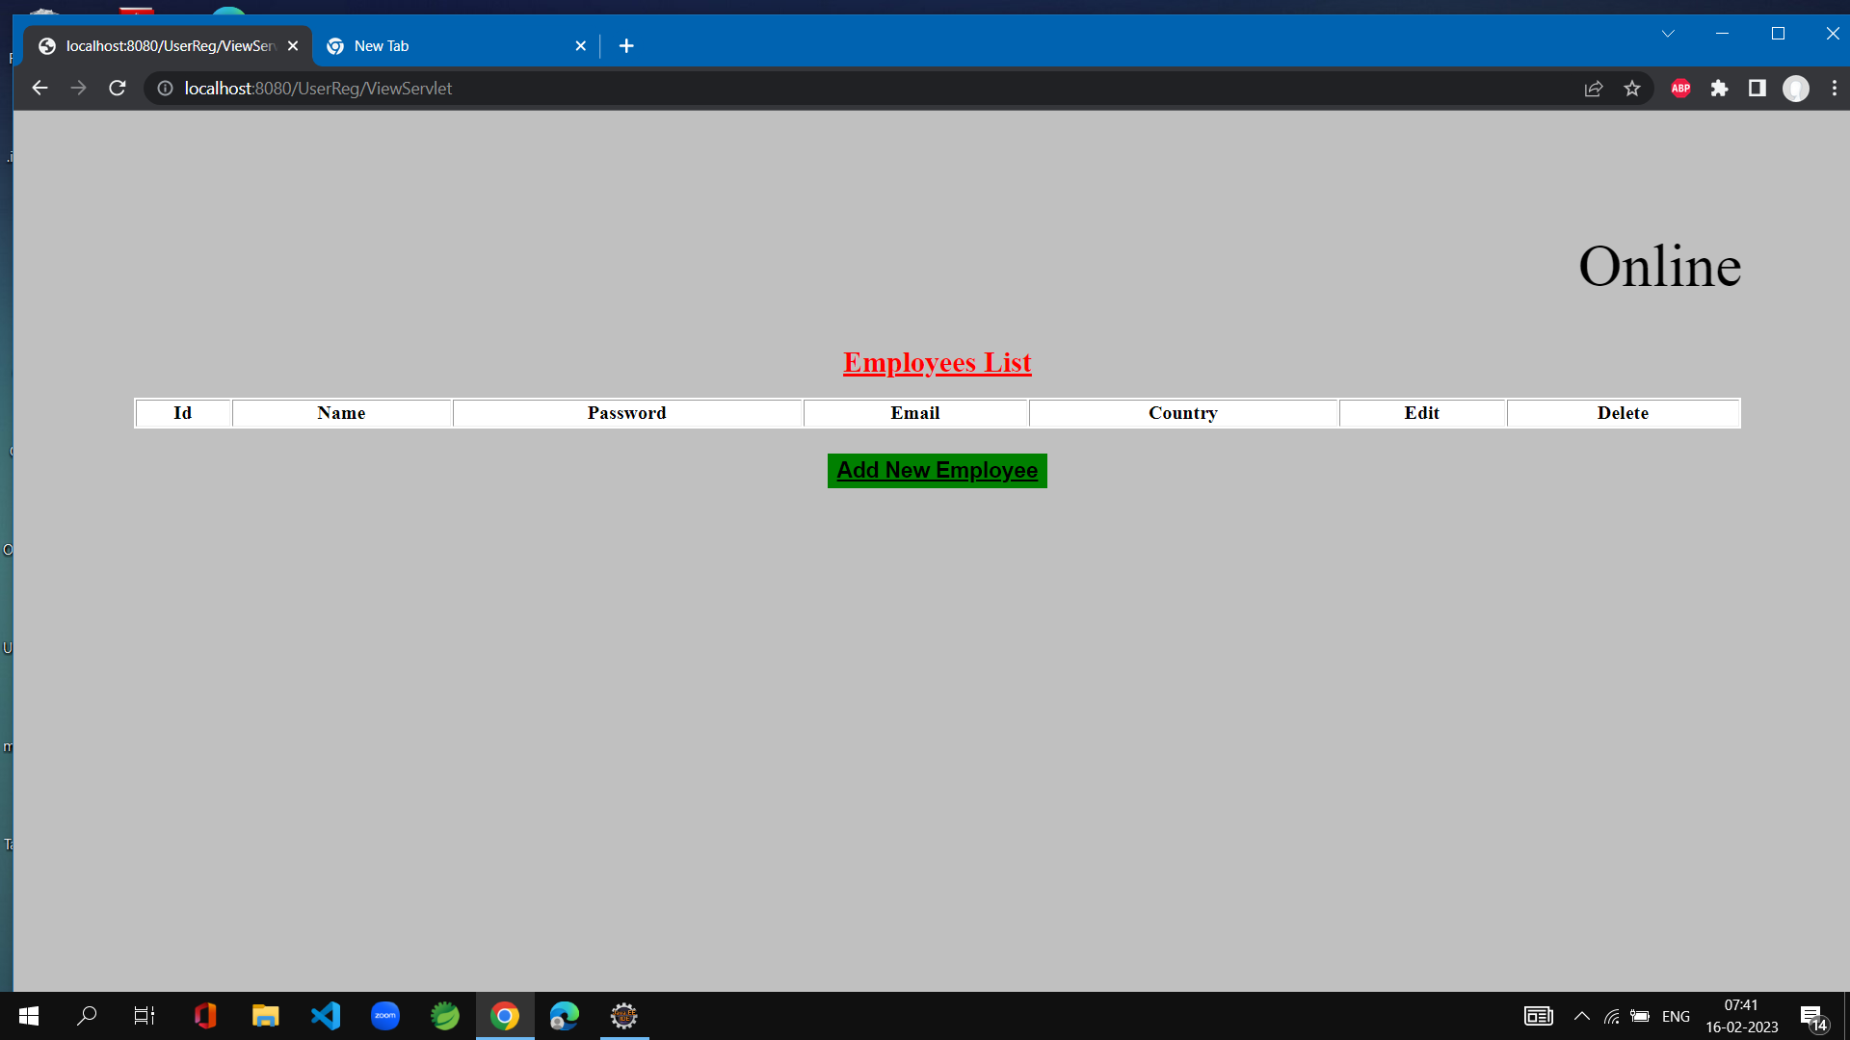
Delete Employee

Slide 17
CONCLUSION
The report’s content comprises the whole task solution, starting from the programming environments have been selected, going through the database, the application’s analyze and construction, and finishing with the code-implementation and test-samples
Since this project has been designed exclusively as a project, certain complexities that do faced by any real life manual problem like total no. of employee, address redundancy etc. are considered in this project. But enhancement to the project can easily be made without changing the current design and programming structure.
We can Visualize the working of entire project by practically Running it.

